Slide 1

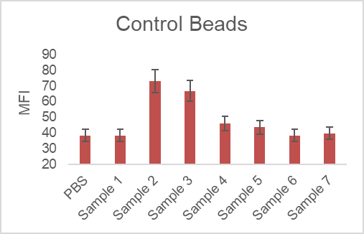
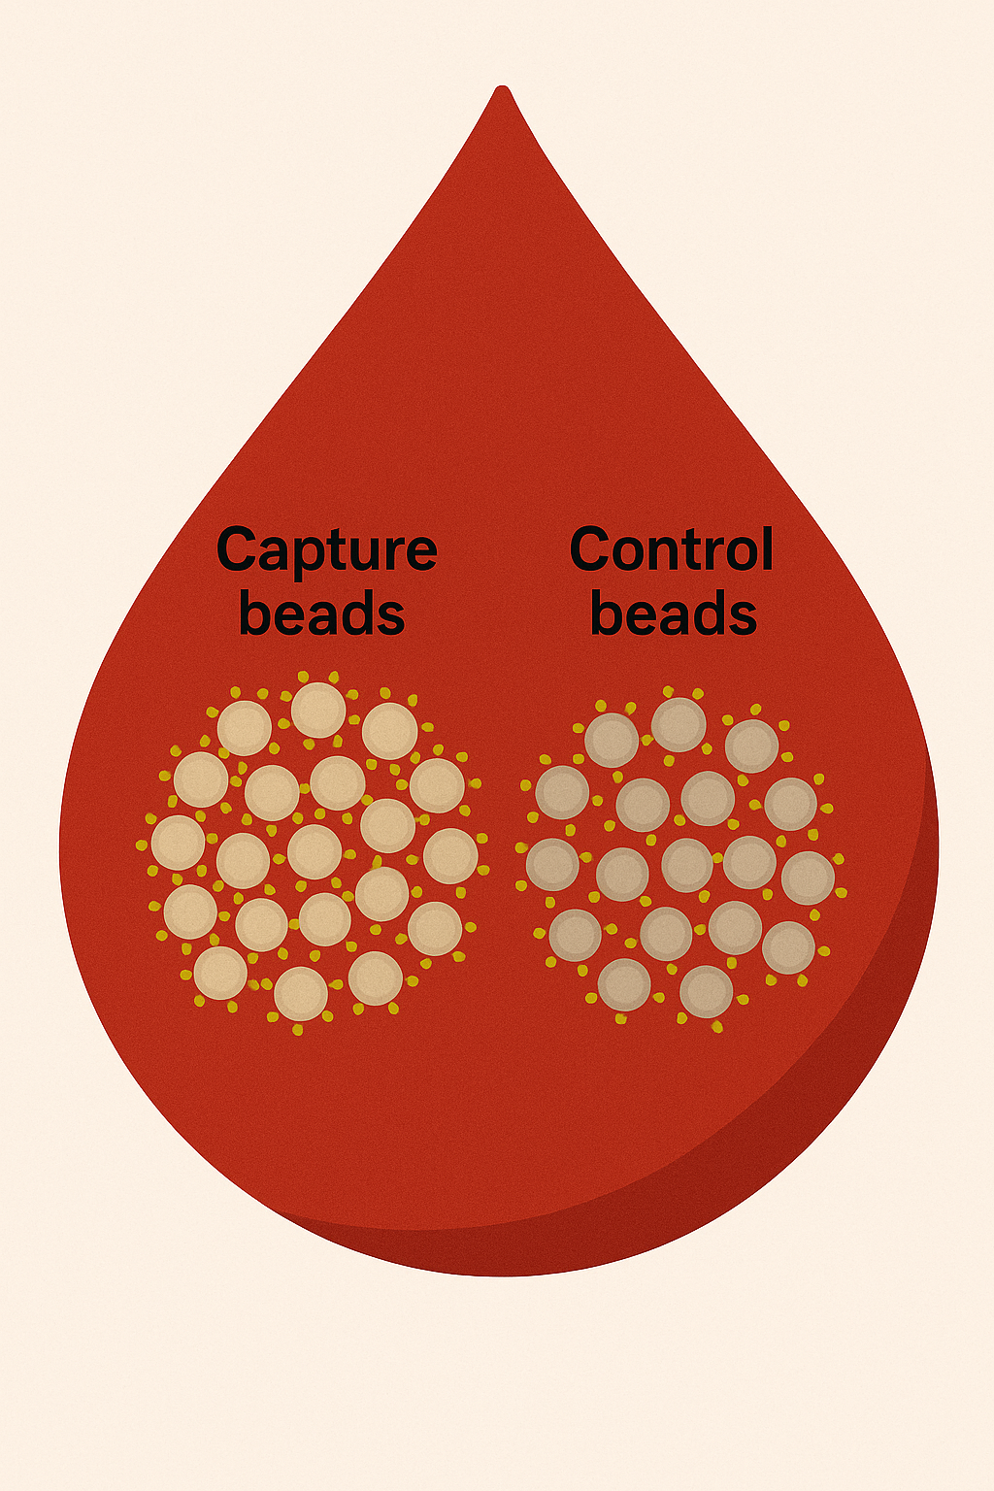
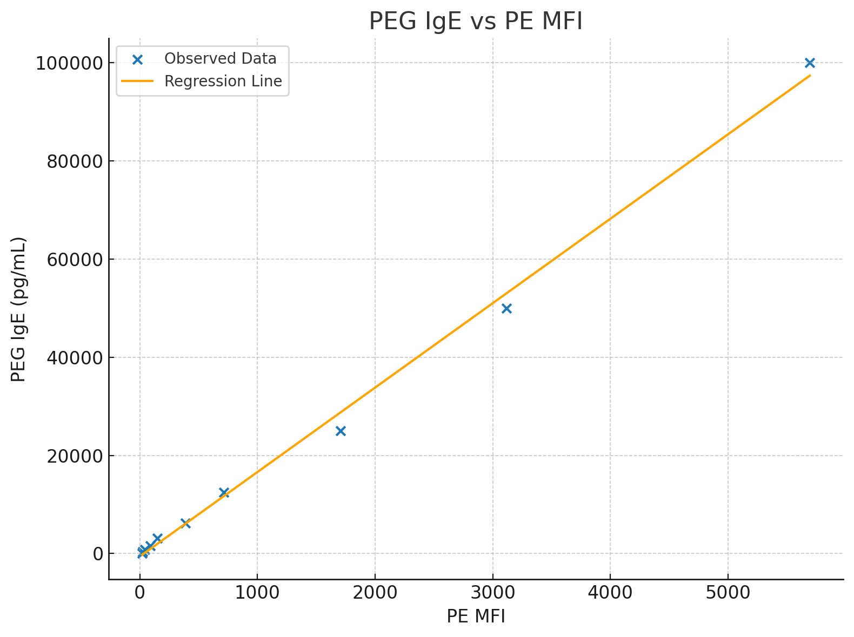
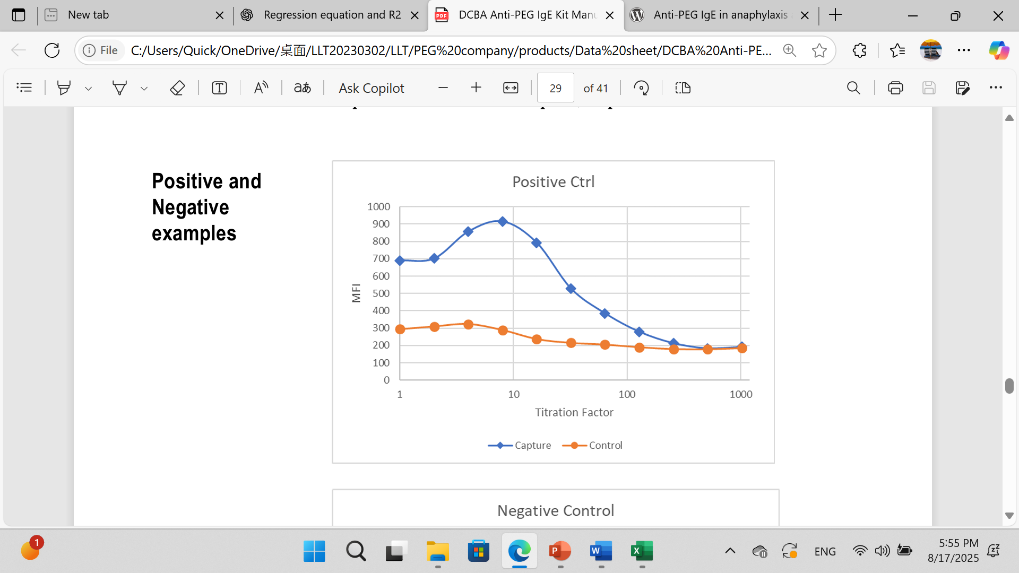
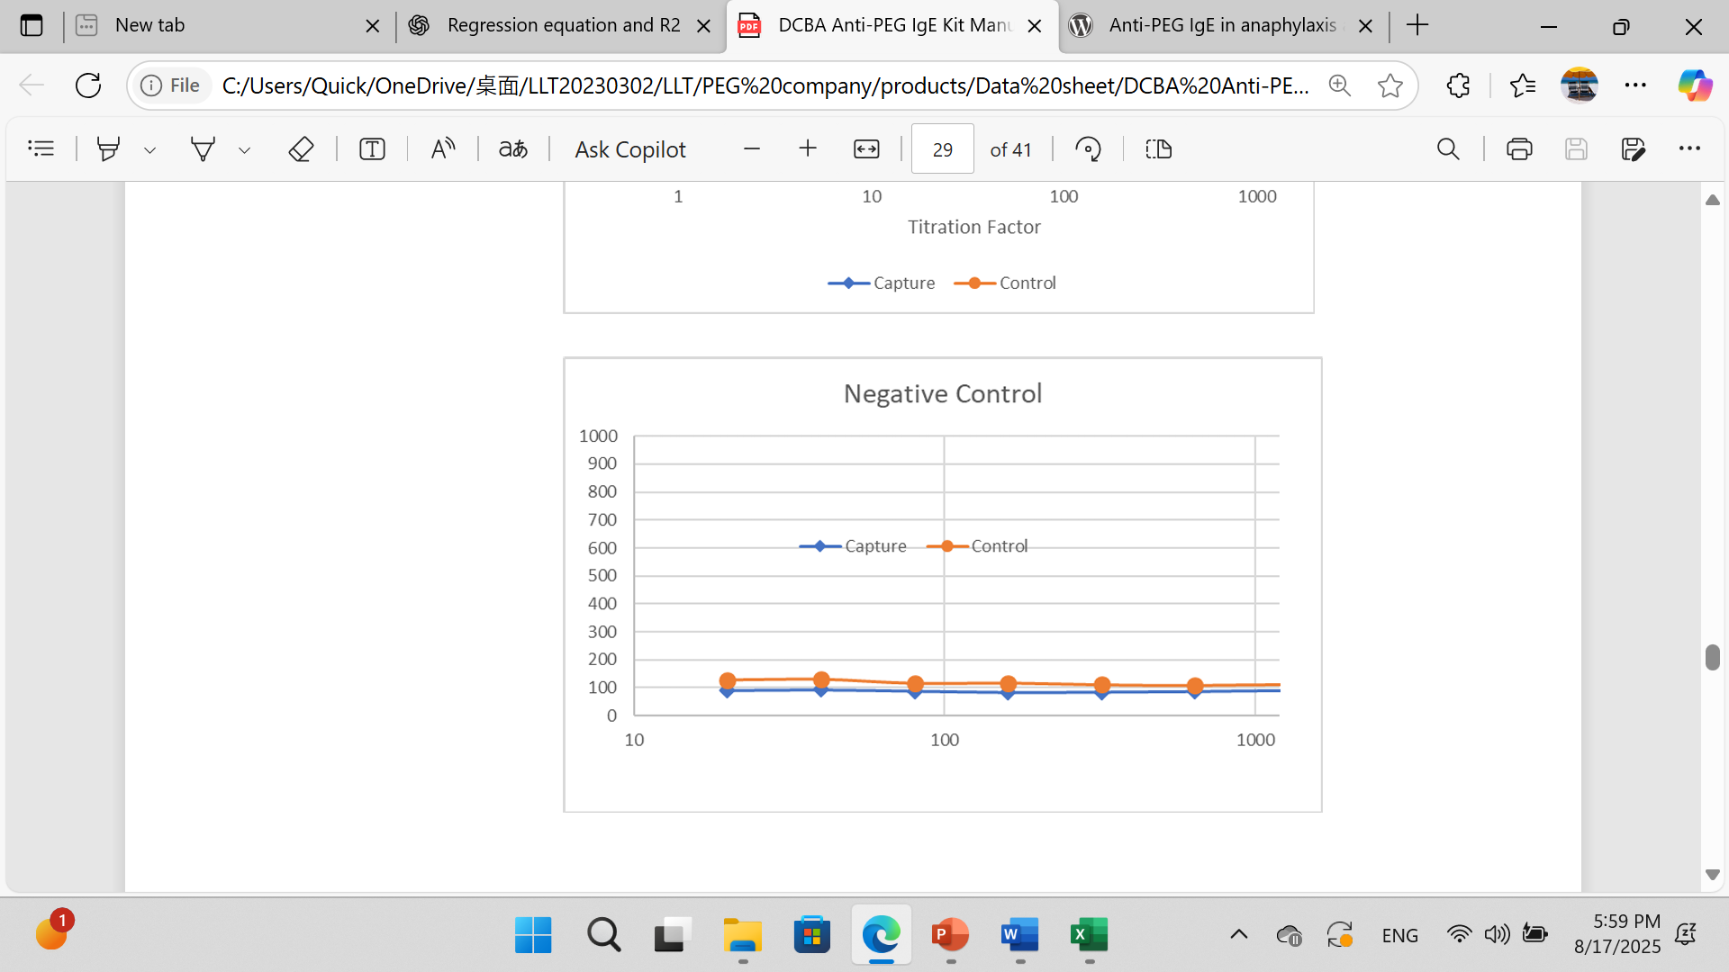
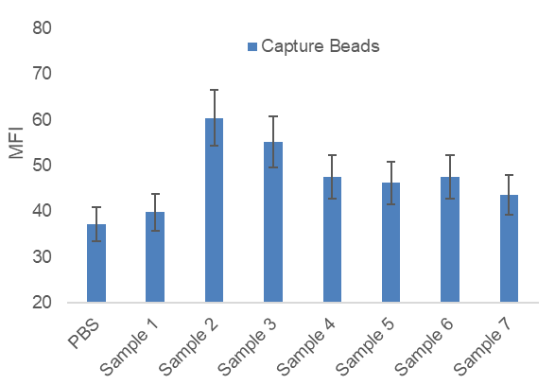
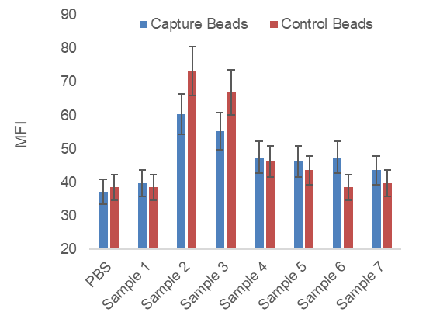
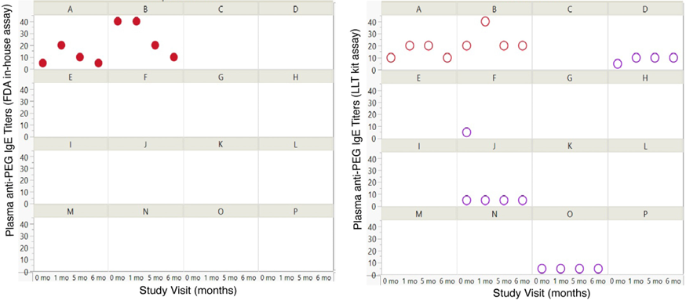
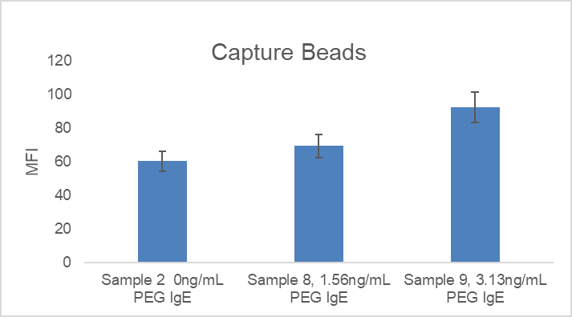
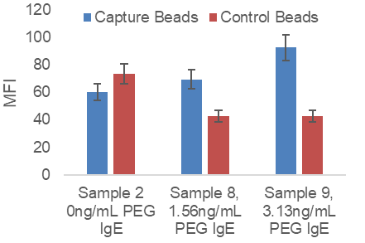
RICHARD DING
LEADING LIFE TECHNOLOGIES, CALIFORNIA, USA
^{TEL:001-650-996-6078}
WEBSITE: PEG.LEADINGLIFETECHNOLOGIES.COM
EMAIL: INFO@LEADINGLIFETECHNOLOGIES.COM
DETECTION OF POLYETHYLENE GLYCOL (PEG)–SPECIFIC IGE
BY THE FOCALTUNING™ IMMUNOASSAY PLATFORM
BACKGROUND Polyethylene glycol (PEG), long regarded as biologically inert, has recently been identified as a potential immunogenic compound in a small but clinically relevant subset of individuals. PEG-specific immunoglobulin E (PEG IgE) has been implicated in immediate hypersensitivity reactions, including anaphylaxis. However, conflicting reports and variability in assay performance have contributed to ongoing controversy about PEG’s true allergenic risk. In this context, improved diagnostic accuracy is essential for clarifying the clinical relevance of PEG IgE and identifying individuals at risk. The FocalTuning platform is a flow bead-based proprietary immunoassay platform.
Conclusion FocalTuning™ offers superior analytical performance for PEG IgE detection by integrating intra-sample controls and precise signal deconvolution. To fully establish the role of PEG IgE in the allergy and anaphylaxis of PEG-containing drugs and vaccines, larger-scale testing across diverse patient populations is needed.
The FocalTuning™ Immunoassay Platform
-A better approach to real control
Pseudo-negative data by single capture beads (left, sample 8) can be avoided by introducing paired control beads as the internal control (right, sample 8)
Detection of PEG specific IgE
-By the first commercial kit on the market
Standard curve of PEG specific IgE One positive and one negative sample
Detection of PEG IgE by FocalTuning was validated by 3rd party in-house assay
Serum PEG-specific IgE was measured at four time points: baseline prior to any COVID-19 vaccination (month 0), one month after the second dose or placebo (month 1), baseline prior to booster administration (month 5), and one month after the booster (month 6). Sixteen participants were enrolled, labeled with alphabetical IDs from A through P. Participants A and B, indicated by red dots, experienced recurrent systemic allergic reactions; both also tested positive for PEG-specific IgE.
Khalid, et al, 2024
78ng/mL PEG IgE
PEG IgE=17.20×PE ΔMFI−586.79
R2=0.996
Δ
Δ
Inter-sample background uncovered
Different samples have different background signals
PBS: phosphate buffered saline with 5% BSA
Samples 1-4: four different normal human plasma samples
Samples 5-7: three different normal human serum samples
Intra-sample background removed
Target signal can be reliable only when intra-sample background measured.
Capture beads bearing background and target signal
Control beads bearing background signal only
The difference in between representing target signal
Pseudo-positive data by single capture beads (left, samples 2 and 3) can be avoided by introducing paired control beads as the internal control (right, samples 2 and 3).
REFERENCES
Zhou, et al. Anti-PEG IgE In anaphylaxis associated with Polyethylene Glycol. J ALLERGY CLIN IMMUNONOL PRACT. 2020.
Khalid, et al. A randomized double-blinded trial to assess recurrence of systemic allergic reactions following COVID-19 mRNA vaccination. J ALLERGY CLIN IMMUNOL. 2024.

